Slide 1
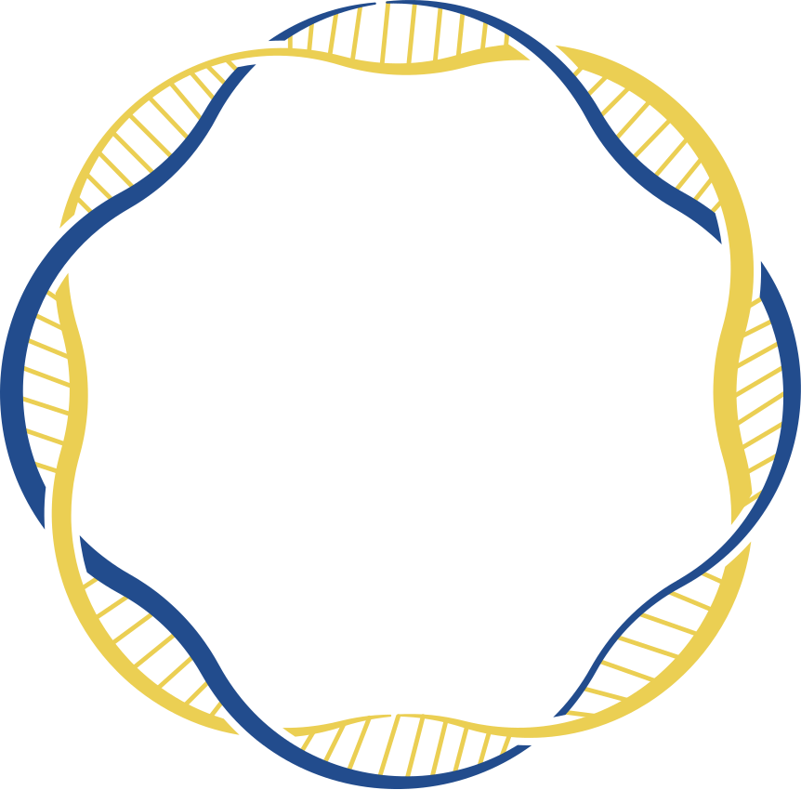



SummerCamp’24
By Talan Innovation Factory- Talan Tunisie

Slide 2
CONTENT
01
INTRODUCTION
02
PROBLEM STATEMENT
03
THE BODY'S RAW MATERIALS
04
CHALLENGES IN STEM CELL REGENERATION
05
SOLUTION
06
MARKET STUDY
07
DEMO

Slide 3

1

Slide 4


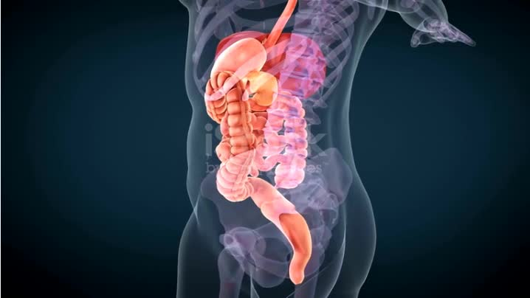
PROBLEM STATEMENT
7-10 million people are living with Parkinson's disease.
537 million people worldwide live with diabetes.
Over 495,000 new cases of pancreatic cancer are diagnosed each year
Heart failure affecting over 26 million people worldwide.
References :
* IDF Diabetes Atlas
* Global Cancer Statistics
* Global, regional, and national burden of Parkinson's disease
* Heart failure: preventing disease and death worldwide
2
Notes:
- Around 2 million deaths each year are attributed to liver diseases, many of which lead to the need for a liver transplant.
- Cardiovascular diseases are the leading cause of death globally, with heart failure affecting over 26 million people worldwide.
- Over 850 million people globally suffer from kidney diseases, and approximately 2 million people are currently undergoing dialysis or are in need of a kidney transplant.

Slide 5




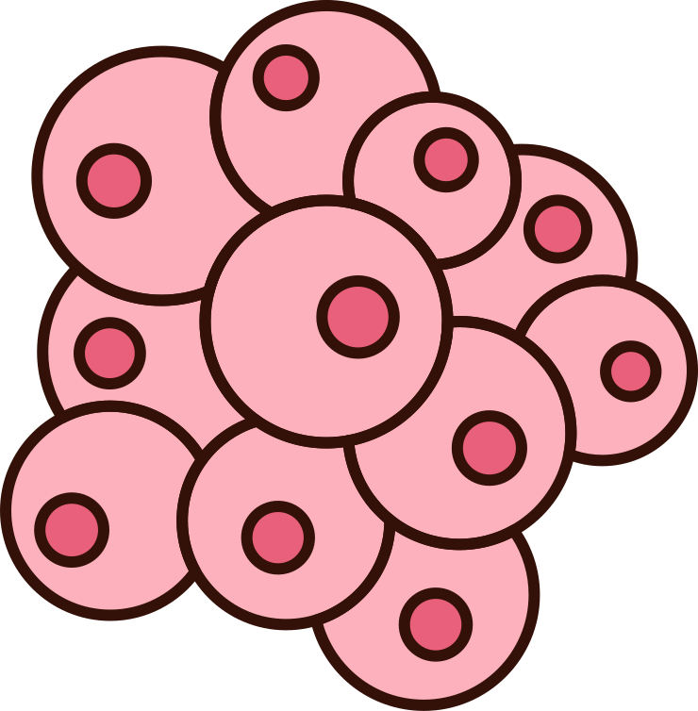
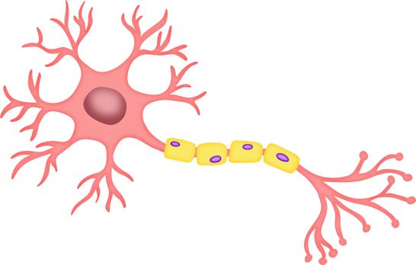

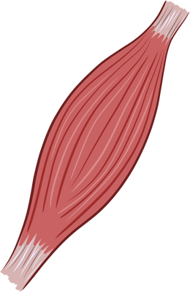


THE BODY'S RAW MATERIALS
Embryonic stem cells
self-renew
differentiation into any cell
immunologic rejection
regulatory hurdles
Adult stem cells
differentiation into a limited types of cells
immaturity
less immunogenic
Induced pluripotent stem cells
3
Notes:
- This is where stem cells come into the picture. Stem cells are the body's raw materials—cells from which all other cells with specialized functions are generated. Under the right conditions, stem cells can divide to form more cells called daughter cells. These daughter cells either become new stem cells (self-renewal) or become specialized cells (differentiation) with a more specific function, such as blood cells, brain cells, heart muscle cells, or bone cells.
-------------------------------------
talk about the 3 types (mention that emryonic stem cells illegal + mention we are going to work on IPSC)

Slide 6

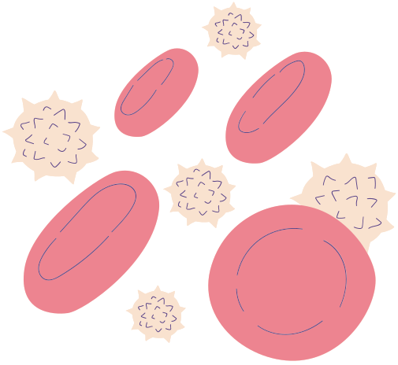



CHALLENGES IN STEM CELL REGENERATION
Stem cell differentiation
Healthiness of the stem cell
Research database
It is difficult to predict what type of cell a stem cell will become.
Unhealthy stem cells can proliferate uncontrollably, potentially leading to tumor formation.
Databases mapping stem cell DNA to potential cell types are limited.
4
Notes:
* Healthiness of the Stem Cell :
-Risk of Tumors: Unhealthy stem cells can proliferate uncontrollably, potentially leading to tumor formation. This makes it essential to thoroughly screen for genetic stability and overall cell health before using stem cells in therapy.
-Successful Integration: Only healthy stem cells can properly integrate into target tissues and perform their intended functions, ensuring the long-term success of the treatment.
* Stem Cell Differentiation
-Uncertain Outcomes: It’s difficult to predict what type of cell a stem cell will become, especially outside the body. Without precise control, stem cells might differentiate into the wrong type, compromising the therapy.
-Controlled Environment: To guide stem cells correctly, they need to be in a carefully controlled lab environment that mimics the body’s signals. However, replicating these conditions perfectly is challenging, and missteps can lead to ineffective or harmful differentiation.

Slide 7
DID YOU KNOW YOU CAN PRINT AN ORGAN
with 3D bio-impression,
just like copying a paper with a printer?
5
Notes:
* Healthiness of the Stem Cell :
-Risk of Tumors: Unhealthy stem cells can proliferate uncontrollably, potentially leading to tumor formation. This makes it essential to thoroughly screen for genetic stability and overall cell health before using stem cells in therapy.
-Successful Integration: Only healthy stem cells can properly integrate into target tissues and perform their intended functions, ensuring the long-term success of the treatment.
* Stem Cell Differentiation
-Uncertain Outcomes: It’s difficult to predict what type of cell a stem cell will become, especially outside the body. Without precise control, stem cells might differentiate into the wrong type, compromising the therapy.
-Controlled Environment: To guide stem cells correctly, they need to be in a carefully controlled lab environment that mimics the body’s signals. However, replicating these conditions perfectly is challenging, and missteps can lead to ineffective or harmful differentiation.

Slide 8

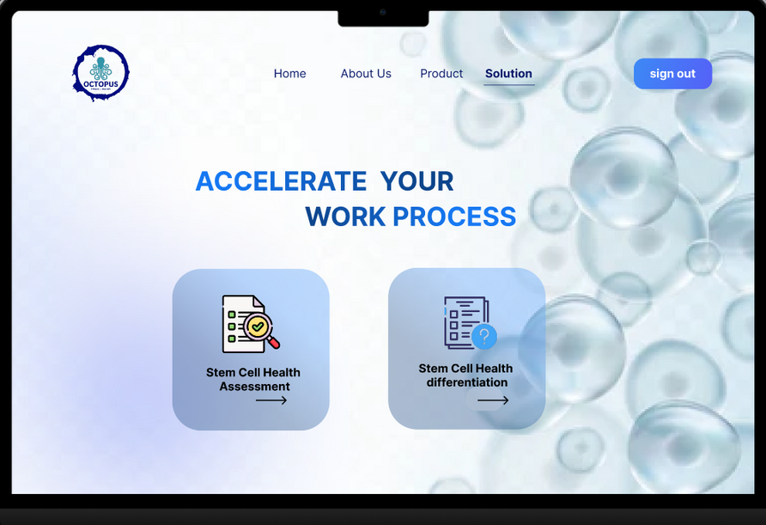
SOLUTION
Determine Healthiness of the stem cell
Accelerate the creation of specific Bio-Inks
Generate accurate predictions of cell differentiation types.
Enriching the research database.
References :
* Evaluating Cell Processes, Quality, and Biomarkers in Pluripotent Stem Cells Using Video Bioinformatics
* ROR2 expression predicts human induced pluripotent stem cell differentiation into neural stem/progenitor cells and GABAergic neurons
6
Notes:
- Analyze videos of stem cell colonies using machine learning, to determine its healthiness.
- Utilizing RAG technique to generate highly accurate predictions of cell differentiation types based on its RNA sequence and associated biomarkers.
- Enriching the research database to help researchers in their stem cell regeneration experiences.
- Accelerate the creation of specific Bio-Inks.

Slide 9
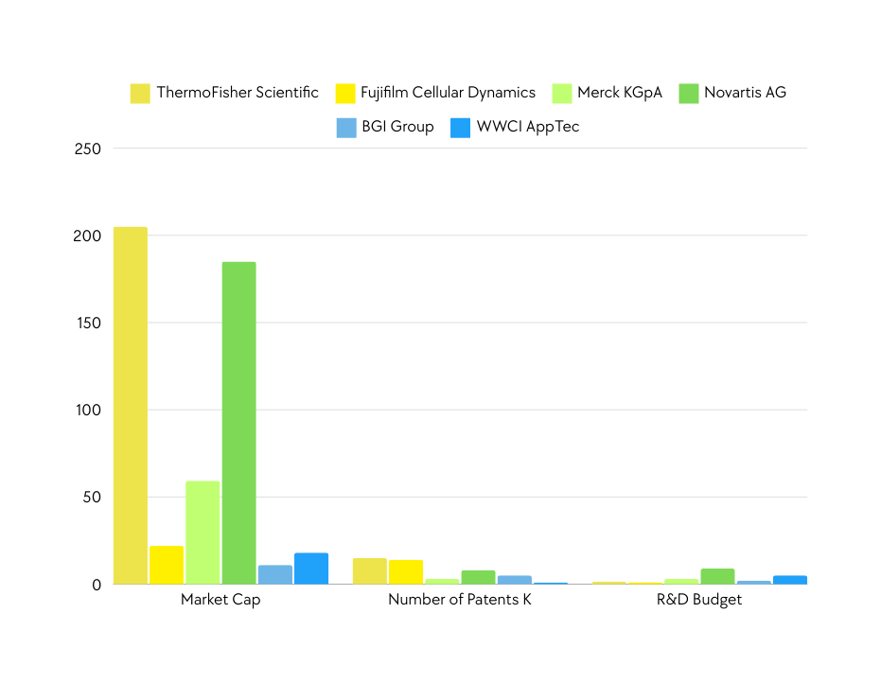
MARKET STUDY
KEY PLAYERS
Fujifilm cellular dynamics, Inc and Thermo Fisher scientific, Inc
PROMISING MARKET
ADOPTION RATE
Market opportunity: iPSCs
iPSCs are being adopted for drug discovery and regenerative medecine.
Better versality and fewer legal and ethical barriers compared to embryonic stem cells.
615M
2028
286M
2024
China
North America
7
Europe
Source : Markets&Markets Analysis

Slide 10
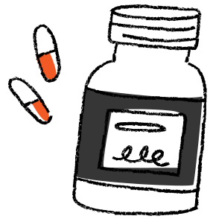
VALUE PROPOSITION
HEALTHINESS
FEATURES DIFFERENTIATION
BIO INK
Our model guarantees the healthiness of the stem cell colony.
We can predict what type of cell is a stem cell going to differentiate into.
We can sell the bio ink needed to regenerate a specific part of the organ.
8

Slide 11



MARKET SEGMENTS
KEY CUSTOMERS IN REGENERATIVE MEDICINE
PHARMACEUTICAL AND BIOTECHNOLOGY COMPANIES
ACADEMIC AND RESEARCH INSTITUTE
HOSPITALS AND CLINICS
9

Slide 12
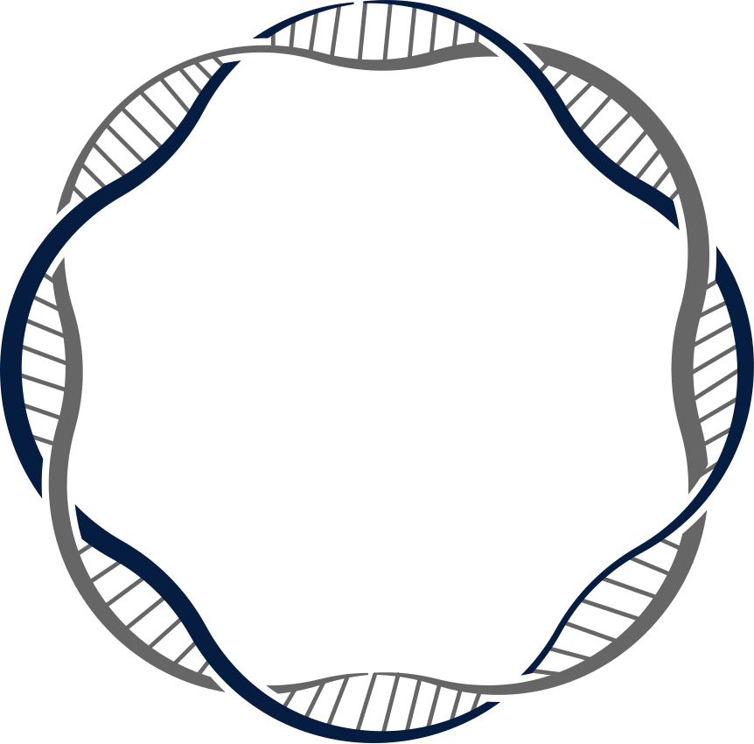

10
Notes:
- This is where stem cells come into the picture. Stem cells are the body's raw materials—cells from which all other cells with specialized functions are generated. Under the right conditions, stem cells can divide to form more cells called daughter cells. These daughter cells either become new stem cells (self-renewal) or become specialized cells (differentiation) with a more specific function, such as blood cells, brain cells, heart muscle cells, or bone cells.

Slide 13

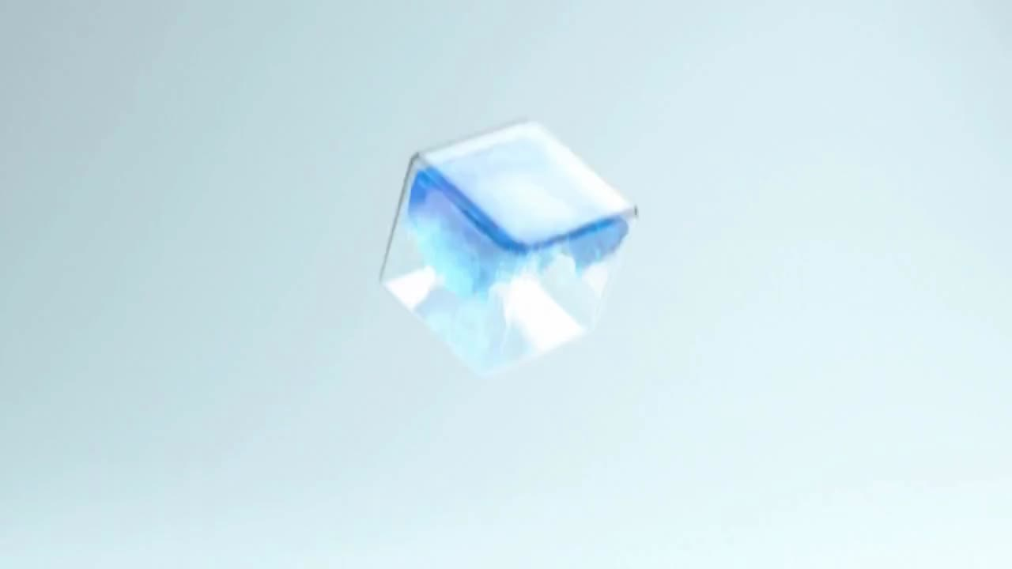

THANKS FOR YOUR ATTENTION
12

Slide 14


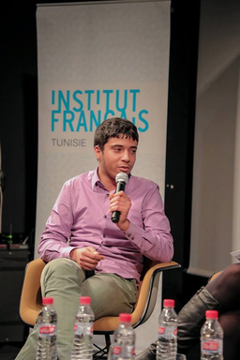







OUR TEAM
Rabie Baccari
Safa Rafrafi
Jasser Dridi
Yasmine Amor
Hadil Affes
Emna Ridene
Louai Azouni
Bilel Bel Hadj Rhouma
Mohamed Jalil Hagoug
11

Slide 15


Slide 16
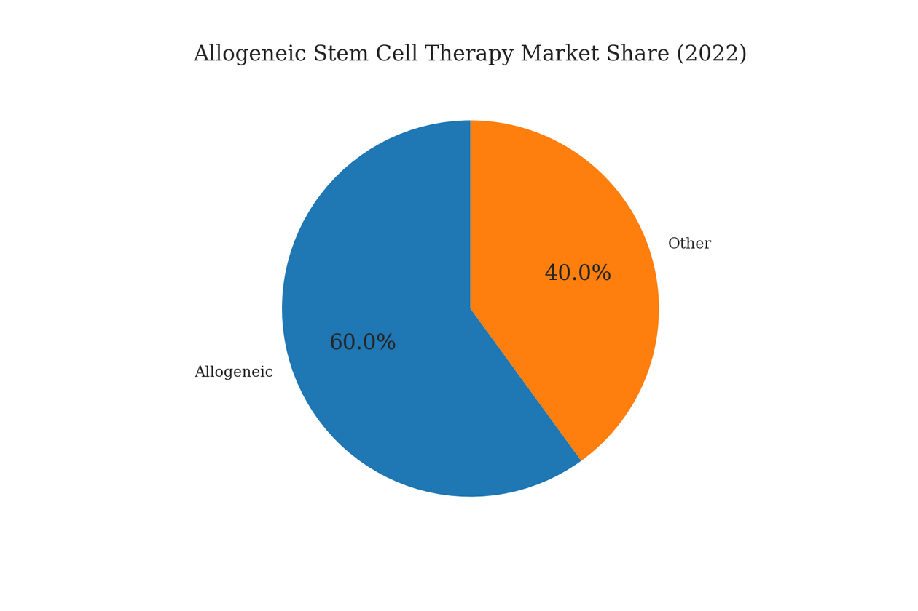
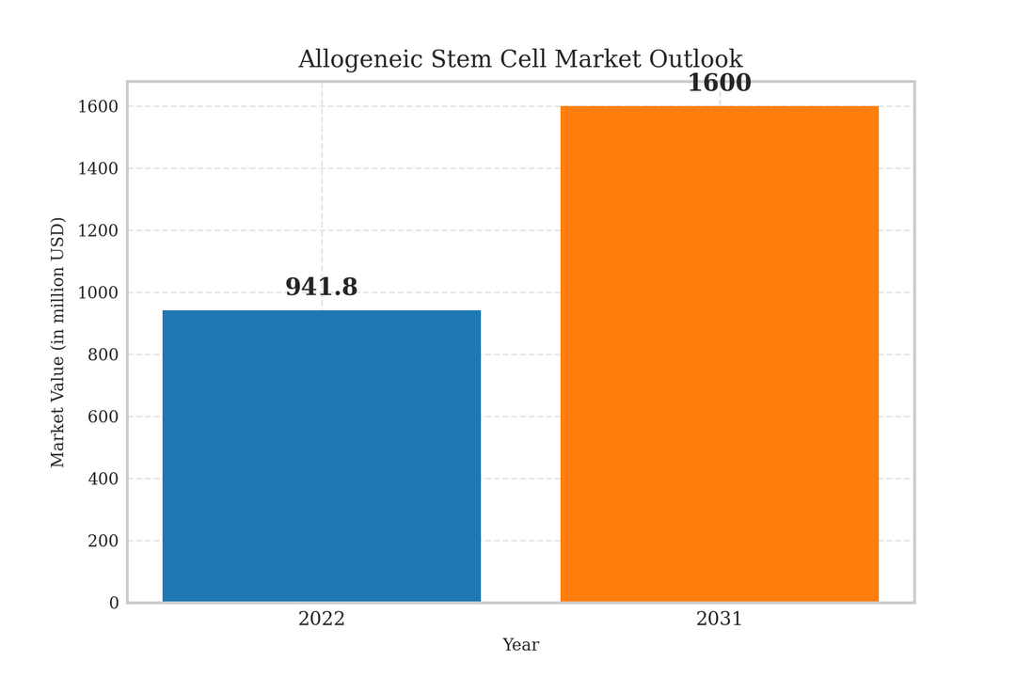
MARKET STUDY
Source : Markets&Markets Analysis
7

Slide 17
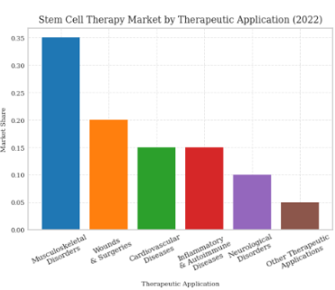
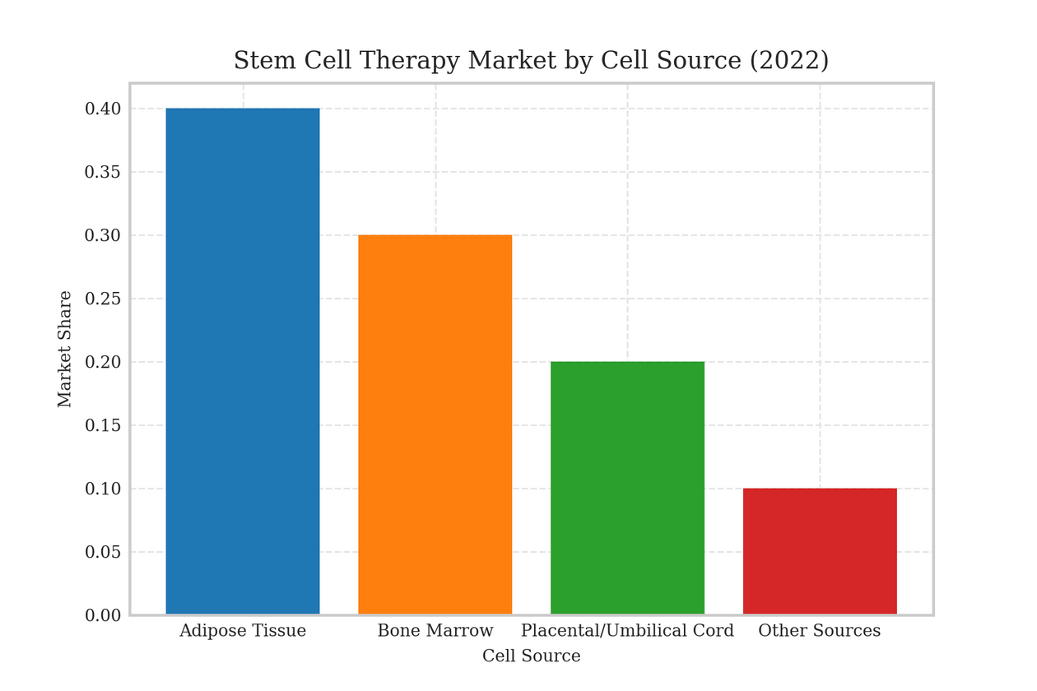
MARKET STUDY
Source : Markets&Markets Analysis
7

Slide 18
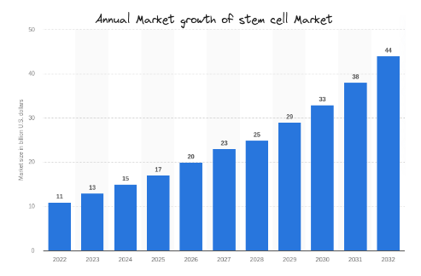
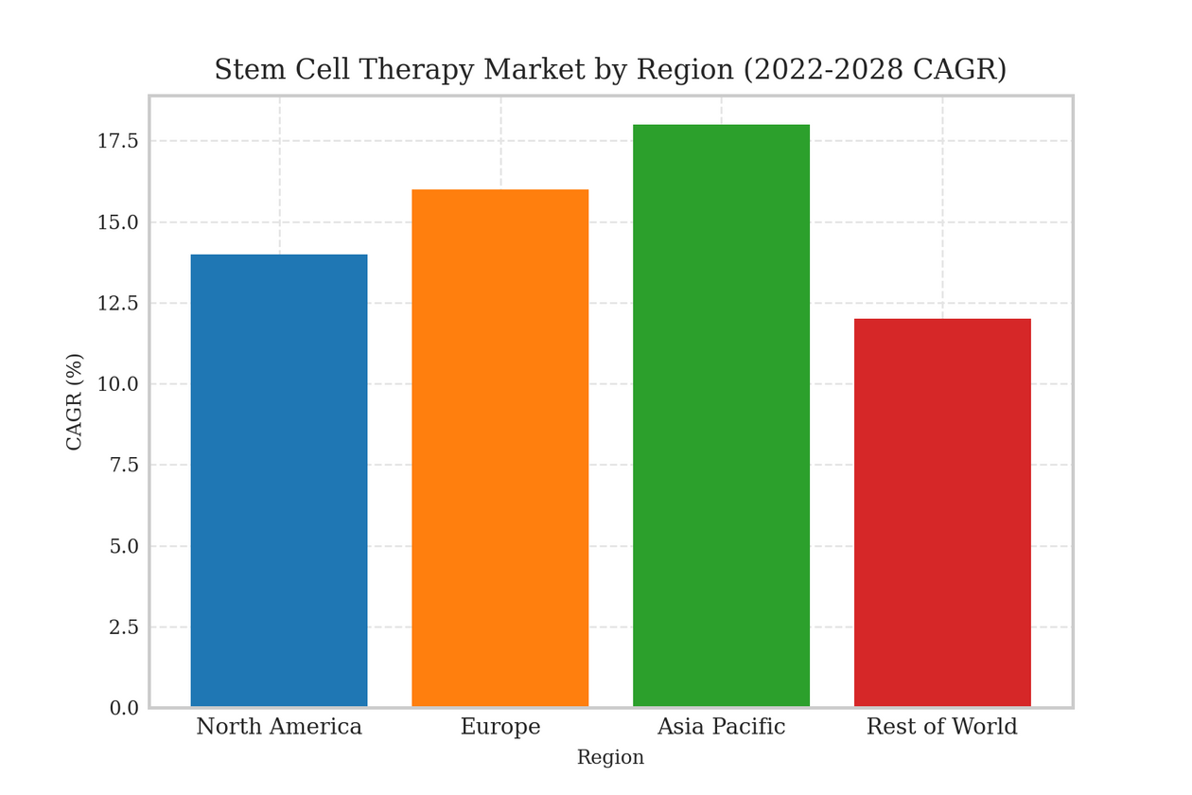
MARKET STUDY
Source : Markets&Markets Analysis
7

Slide 19

REGULATIONS
China has had a rapid growth Initially, there were concerns about the lack of strict regulations, leading to unproven therapies being marketed.
In recent years, China has implemented more rigorous guidelines:
2015 National Guidelines: Introduced stringent regulations requiring clinical trials and government approval for stem cell therapies.
2019 Health Commission and NMPA: Introduced regulations that mandate the registration of clinical trials and tighter control over research activities.
7

Slide 20

REGULATIONS
The United States has a well-established regulatory framework for stem cells, primarily overseen by the Food and Drug Administration (FDA):
FDA Regulation: Stem cell therapies are considered biological products and require extensive clinical trials to prove safety and efficacy before approval.
21 CFR Part 1271: This part of the Code of Federal Regulations outlines the criteria for human cells, tissues, and cellular and tissue-based products (HCT/Ps), which includes stem cells.
Regenerative Medicine Advanced Therapy (RMAT) Designation: Introduced under the 21st Century Cures Act, it provides an expedited pathway for stem cell therapies that address unmet medical needs.
7

Slide 21

REGULATIONS
Europe has a well-structured regulatory framework for stem cells, largely governed by the European Medicines Agency (EMA):
Advanced Therapy Medicinal Products (ATMPs): Stem cell therapies fall under ATMPs, requiring rigorous clinical trials and EMA approval before they can be marketed.
Regulation (EC) No 1394/2007: This regulation specifically covers ATMPs, including stem cell therapies, ensuring they meet safety, efficacy, and quality standards.
Country-Specific Regulations: While the EMA provides overarching rules, individual European countries may have additional regulations.
7

